Slide 1
GLOBAL ELECTRONICS
RETAIL ANALYSIS TO IMPROVE SALES AND EFFICIENT INVENTORY MANAGEMENT

Slide 2
THE COMPANY
Global Electronics, a leading retailer of consumer electronics, has provided with several datasets containing information about their customers, products, sales, stores, and currency exchange rates.
The company seeks to leverage this data to better understand their business and identify areas for improvement.

Slide 3
THE REQUIREMENT
As part of Global Electronics' data analytics team, there is a request to conduct a comprehensive Exploratory Data Analysis (EDA) to uncover valuable insights from the company’s data.
The goal is to provide actionable recommendations that can enhance customer satisfaction, optimize operations, and drive overall business growth.

Slide 4
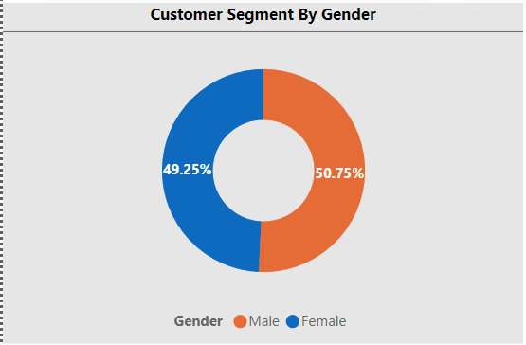
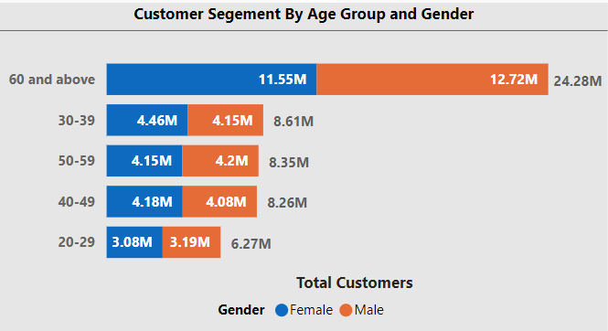
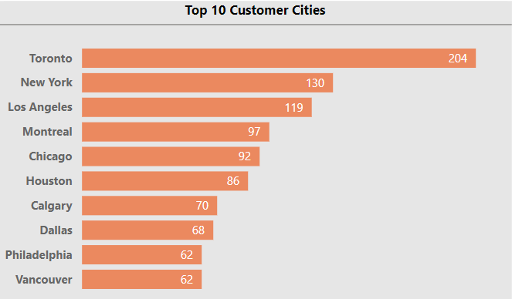
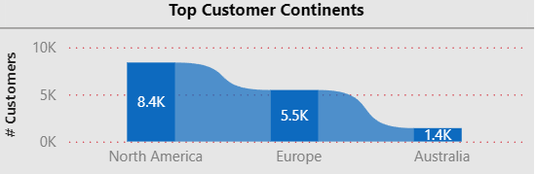
CUSTOMER ANALYSIS
Insights:
▪ Gender distribution appears to be evenly balanced. This suggests that the retailer’s products might be appealing to both genders.
▪ The customer base is predominantly composed of individuals aged 60 and above, and the youngest in the age group of 20-29 represents a significantly smaller portion
▪ Majority of customers are from North America followed by Europe and Australia. Toronto is leading in the US, followed by the ones in Canada including Montreal, Calgary and Atlanta.

Slide 5
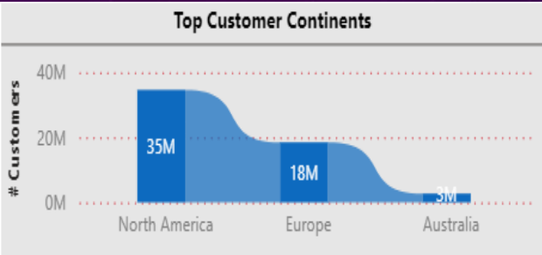
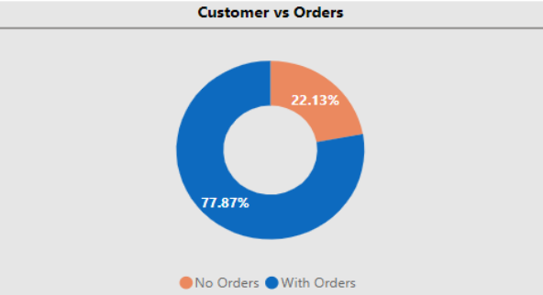
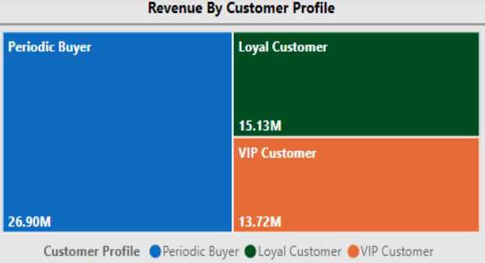
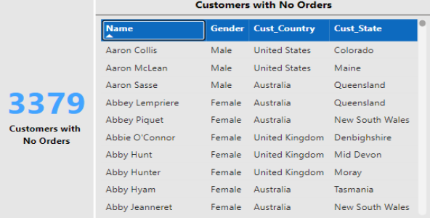
CUSTOMER-SALES ANALYSIS
Insights:
▪ North America tops with most customers and highest revenue, followed by Europe and Australia. Toronto leads amongst the other cities.
▪ Periodic buyers with purchase frequency of 5-10 orders generates almost 50% of revenue and the remaining together by the loyal and VIP customers
▪ 22.13% customers with no orders indicate an action to be taken.
▪ Gender distribution seems to be contributing equally to the revenue

Slide 6
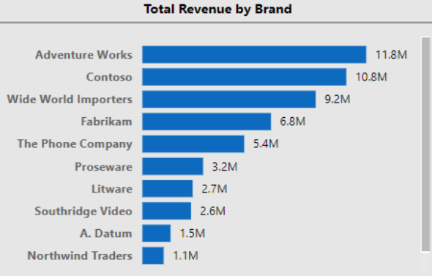
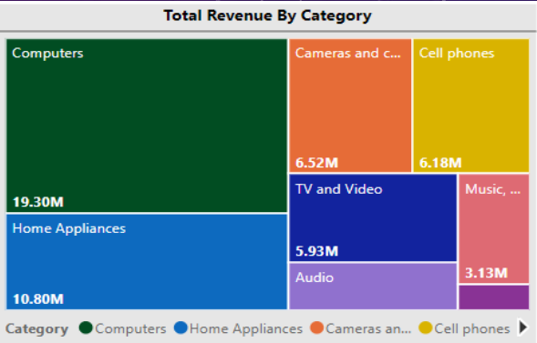
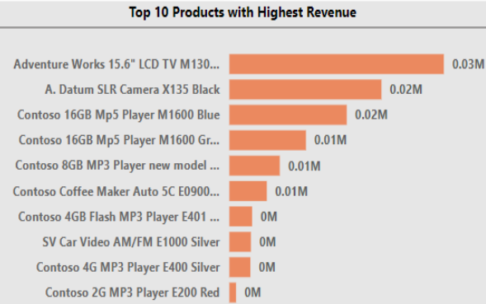
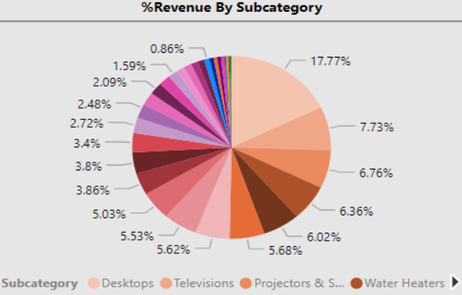
PRODUCT-SALES ANALYSIS
Insights:
▪ Leading Brands: Adventure Works leads followed by Contoso and WWI. Lead by ‘Adventure Works’ indicates strong brand recognition and customer preference. Marketing and product quality likely contribute to this brand's success.
▪ Top Category and Subcategory: Computers are the most popular
category followed by Home Appliances, Cameras and Cell Phones. In the subcategory, Desktops has a significant 17.77% revenue.
▪ Top Products: The highest-selling products are from Adventure
Works and Contoso. This suggests a high demand for these products among customers, potentially due to specific features or competitive pricing.

Slide 7
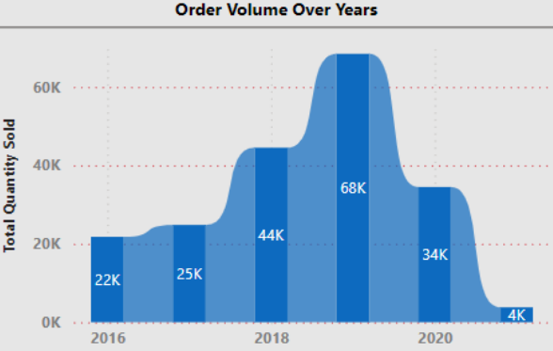
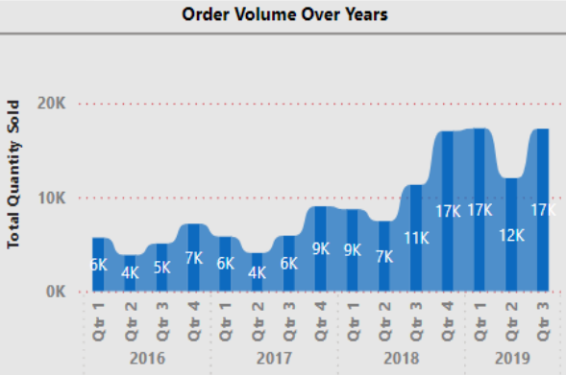
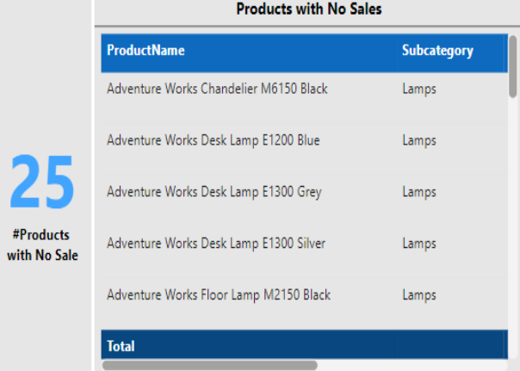
PRODUCT-SALES ANALYSIS
Insights:
▪ Highest number of orders in 2019 might be due to COVID ▪ Quarter 2 every year has recorded the least revenue and a peak revenue in Quarter 4 and Quarter 1
▪ There are 25 Products with no sales indicate further analysis and appropriate action. The subcategory seems to be mostly Lamps.

Slide 8
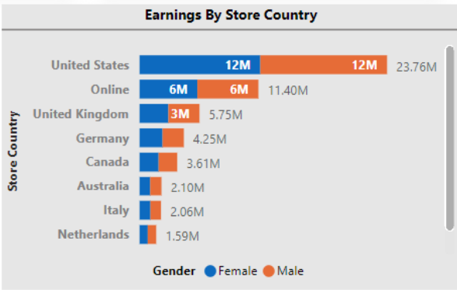
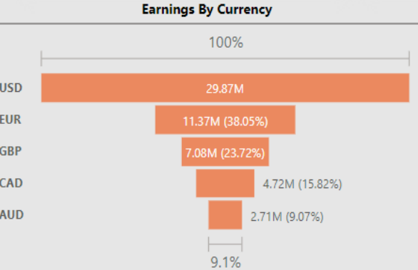
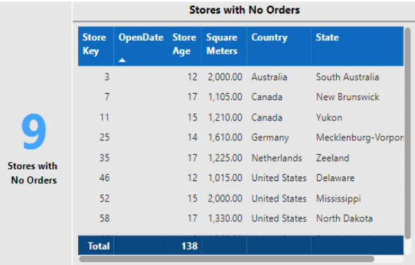
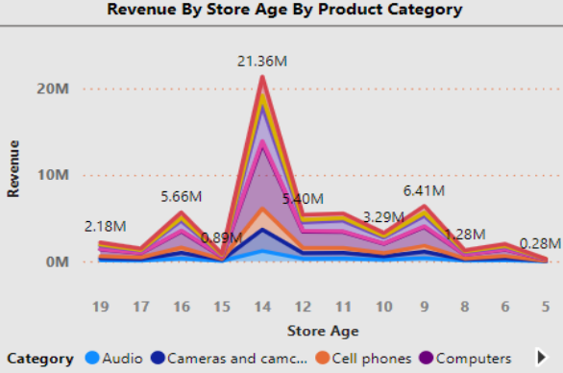
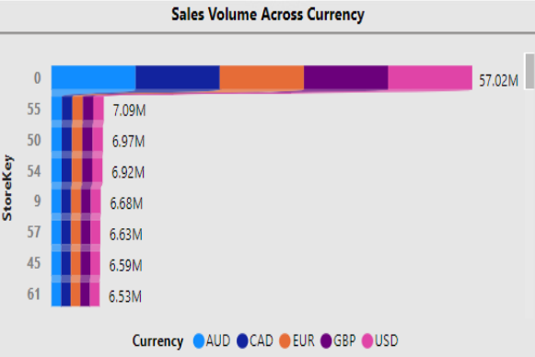
STORE & CURRENCY ANALYSIS
Insights:
▪ US tops with the highest revenue and gender does not have any correlation to the revenue generated
▪ USD is the most widely used currency
▪ Online Store (Store #0) made more than 50% with almost equal contribution by all currency types
▪ 9 stores with no sales indicates further analysis

Slide 9
THANK YOU

